Slide 1
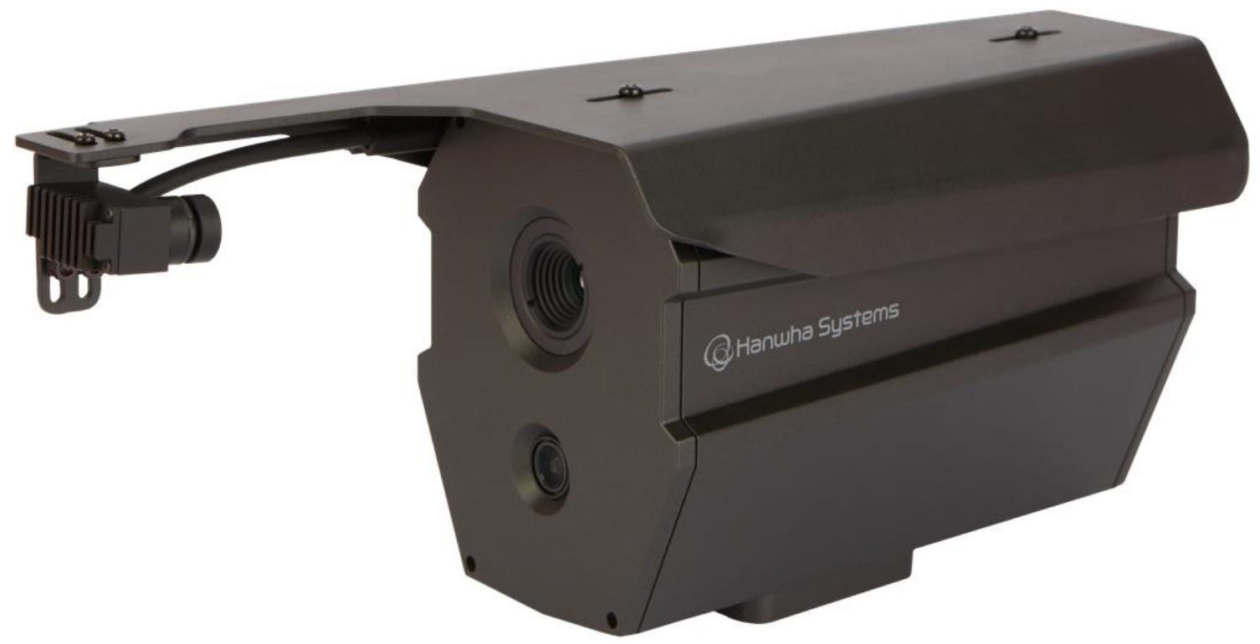
Quantum Eye MPDC
For multipurpose projects
Accuracy
Expandability
Efficiency
Accurate temperature
Measurement and
High quality imaging
Supports various video
Formats for multiple
applications
Low cost, space free,
comfortable,
easy installation
It is a high-precision thermal image + real image camera
that can accurately measure human body temperature in real time.
Built-in Hanwha Systems' patented TRSM module enables accurate heat detection in various environments, and uses intelligent SW to detect real-time heat generators and those not wearing masks to control access.
Using NVIDIA Jetson Nano board, AI function can be installed,
and it can be used for various projects.
Key Features
dual edge camera
Temperature accuracy within ±0.3℃ (with TRSM)
AI function can be installed
Provides various interfaces such as Ethernet, HDMI,
Audio In/Out, and USB
Use in various fields such as human body heat detection,
Smart farm, and livestock disease prevention

Slide 2
Quantum Eye MPDC Technical Specifications
Thermal Camera
Total pixels | 320(H) x 240(V) Pixels
Image Sensor Type | Micro Bolometer
Pixel Pitch | 12μm
Spectral Band | LWIR 8~14 µm
NETD | < 50mK @F/1.0
Field of View ( H x V ) | H: 28°, V: 21°, custom
Temperature Measurement Range | Febrile Sensing Mode : +30 °C ~ +40 °C Normal Mode : ~ +140 °C or ~ +500 °C
Temperature Accuracy | Febrile Sensing Mode : ±0.5 °C (w/ TRSM ±0.3 °C) Normal Mode : ±2°C or 2%
Frame Frequency | MAX 30 FPS
Color Cameral
Image Sensor | 1/2.8" 2MP CMOS
Effective Pixels | 1920 x 1080
Max. Resolution | 2MP
Focal Length | 4 mm
Aperture | F1.6
Field of View | H: 87.6°, V: 46.4°, D: 104.5°
Frame Frequency | MAX 30 FPS
Focus Mode | Fixed
Interfacel
Ethernet(Network) | 1000Base-T, RJ-45
Audio Input | 1 (Mic In)
Audio Output | 1 (Speaker Out)
Alarm Input | 1
Alarm Output | 1
Micro USB Connector | 2
Power LED | 1
Reset Botton | 1
HDMI | 1
Other
Supply Voltage | DC +12V ±10%
Power | 20.0 Watt
Color | Black
Material | Aluminium
External Dimension (H x V x D) | 103.0mm x 118.0mm x 288.0mm (TRSM mounting)
Body Weight | 1.2 Kg
Operation Temperature | -10°C to +35°C (Humidity: 0%RH ~ 95%RH)
Storage Temperature | -30°C to +60°C (Humidity: 0%RH ~ 95%RH)

Slide 3
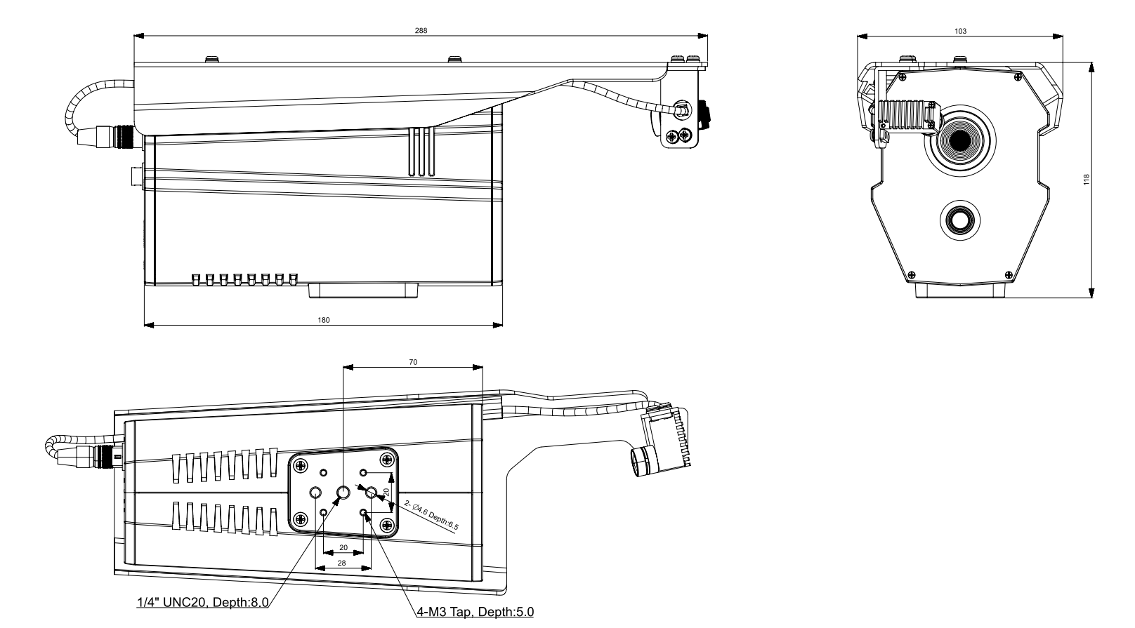
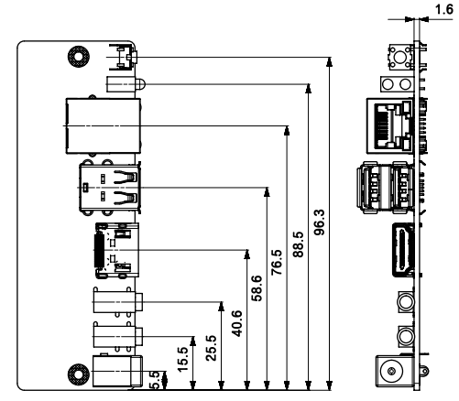
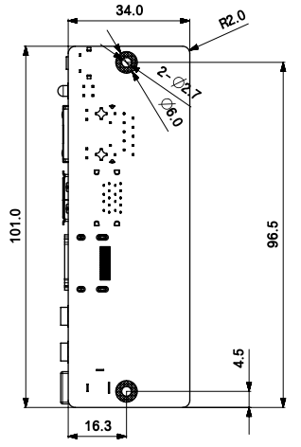
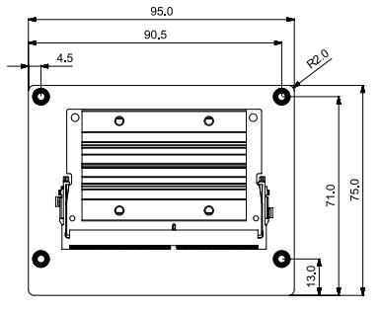
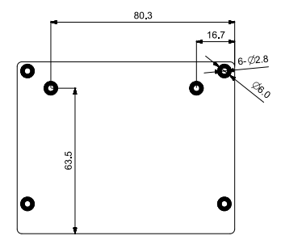
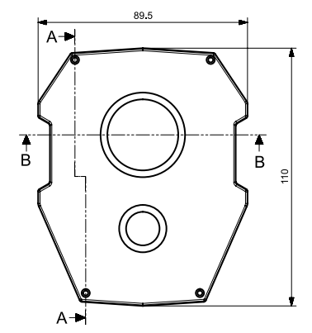
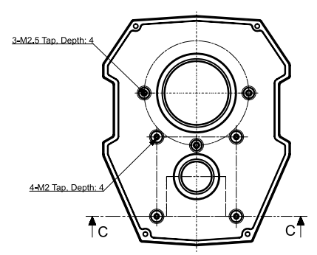
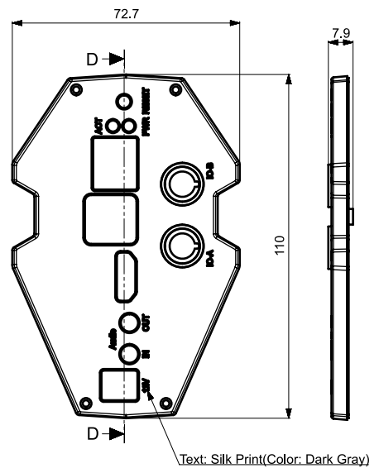
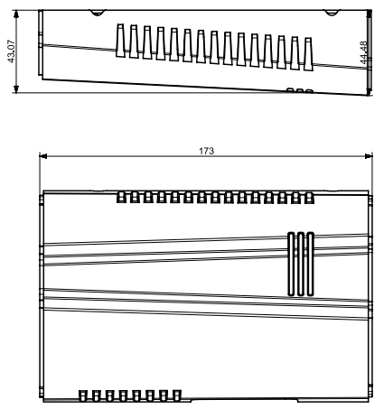
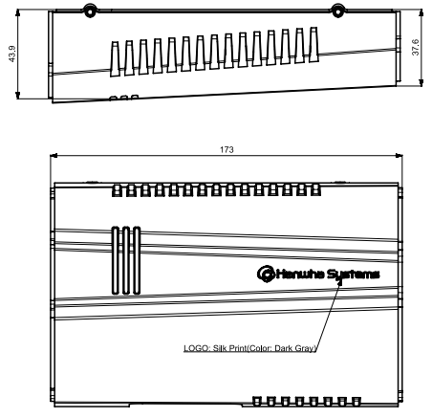
Quantum Eye MPDC Dimensions
Exterior Dimension
Jetson nano Interface Dimension
Cover Dimension

